Slide 1
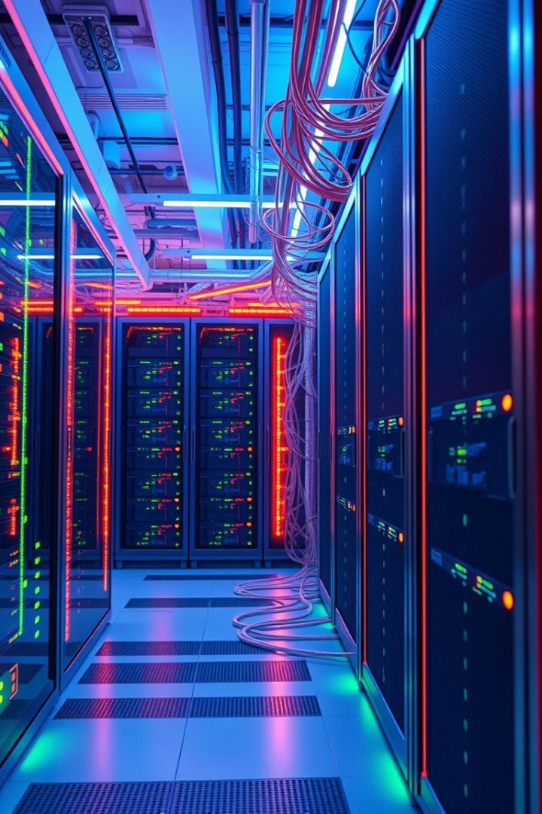
Secure and Robust Enterprise Network Design and Implementation
MAJOR PROJECT (MS-21)
Presented by ADITYA JOSHI
(MSC IT 2 YEAR)

Slide 2

Introduction: Why Secure Networks Matter
Cybercrime Costs
Data Breach Impact
Projected $8.4 trillion globally by 2025
Average cost is $4.35 million per breach (IBM, 2022)
Core Principles
Ensure confidentiality, integrity, and availability

Slide 3
Contents of this
presentation
Introduction | Just a quick introduction about the project.
Team Members | Introducing team members and their roles in the project.
Project Description | Description of the project and what it can do.
Project Overview | Explaining the project.
Test Connectivity | A detailed look at the connectivity between the devices.
Conclusion | Description of the problems that the project overcame.

Slide 4
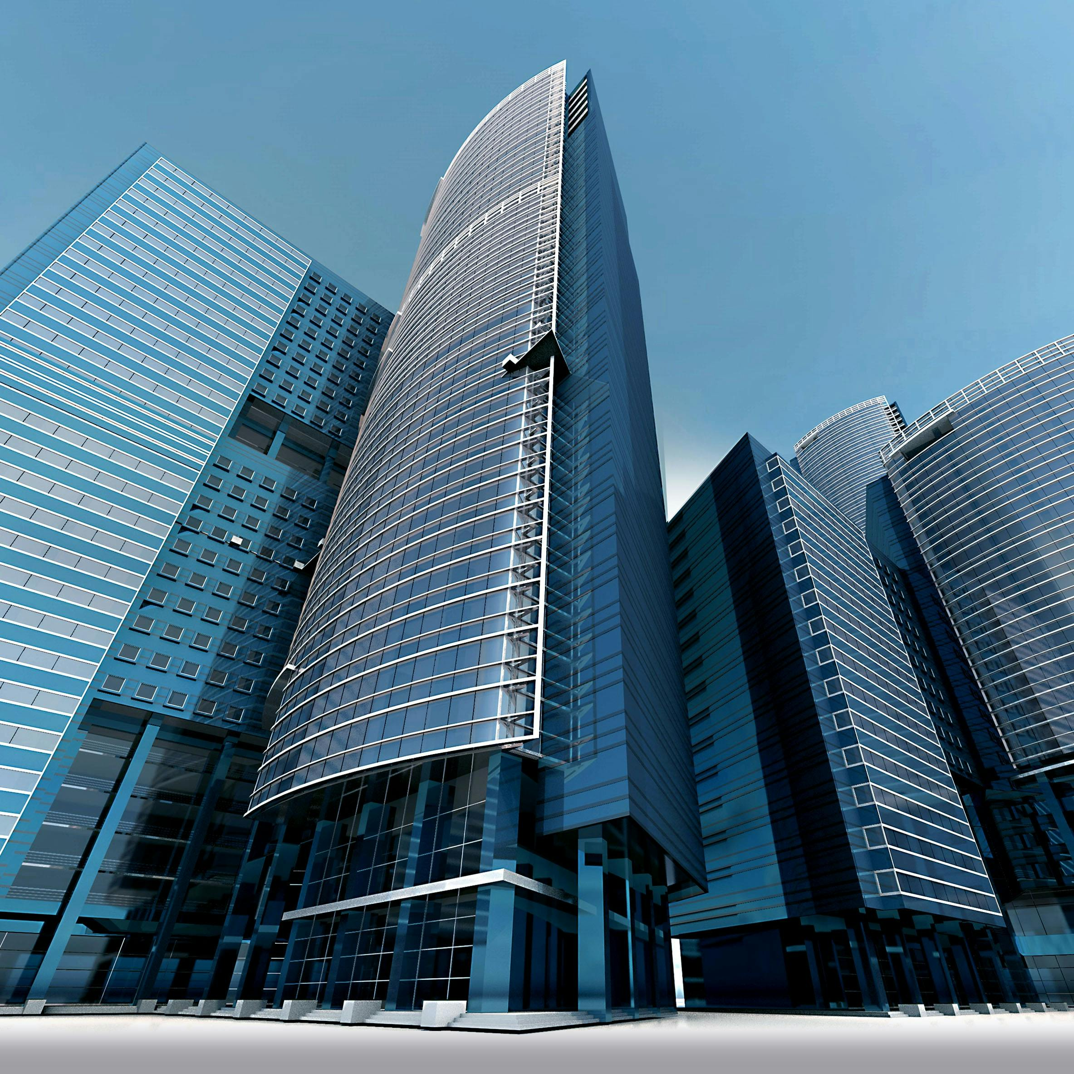
INTRODUCTION
In today's interconnected world, a secure and
well-structured network is crucial for
multinational IT companies to ensure
efficient communication, data
integrity, and protection against cyber
threats. This project outlines the design and
implementation of a robust scalable, and
secure network tailored for a multinational
IT enterprise.

Slide 5


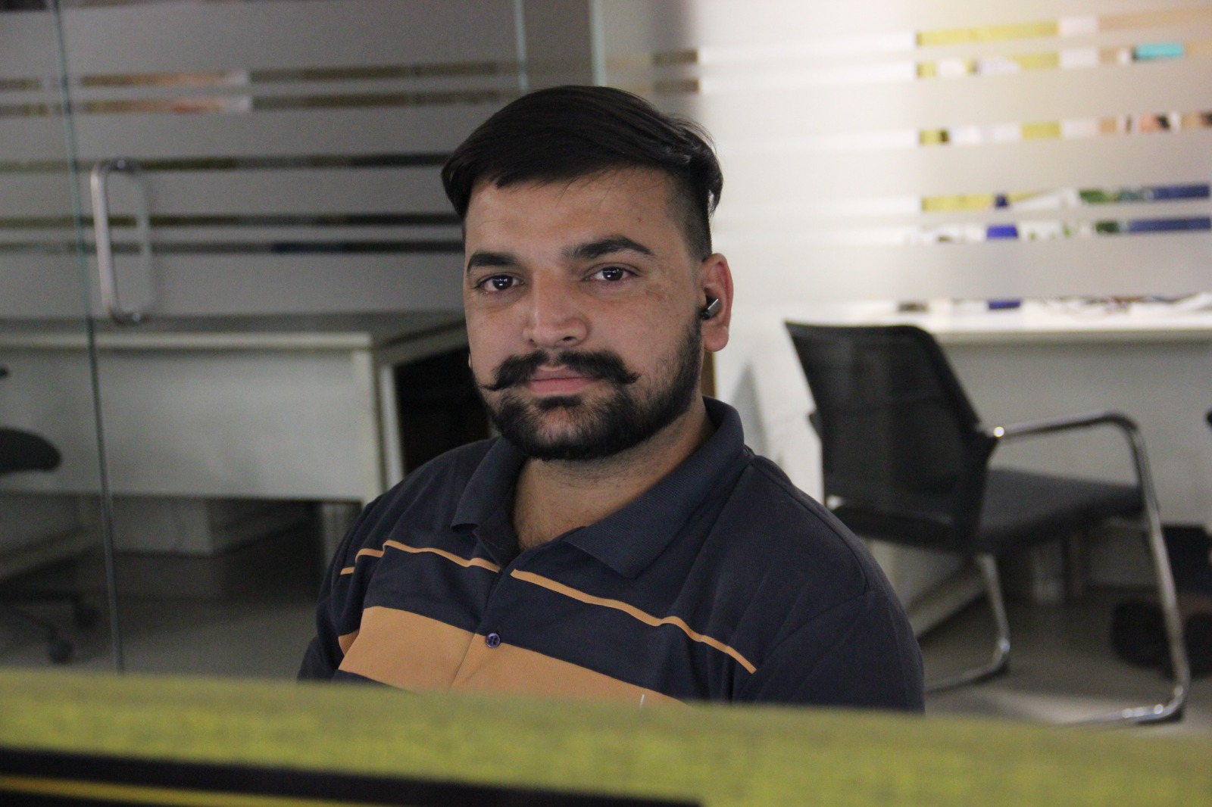
My Amazing Team
Gurpreet Singh
Aditya Joshi
Adarsh Patiyal
Configured switch port security, port security and allocate all the DMZ servers including web, email and NAS. Also done the great task with availing VoIP in every department.
Created system design and connected the devices with correct cables. Configuration of basic device setting. Allocated IP to the bottom layer including inside servers.
Configured firewalls and various servers for DHCP routing to increase the availability of the system. Balance the load among firewalls using HSRP protocol.

Slide 6
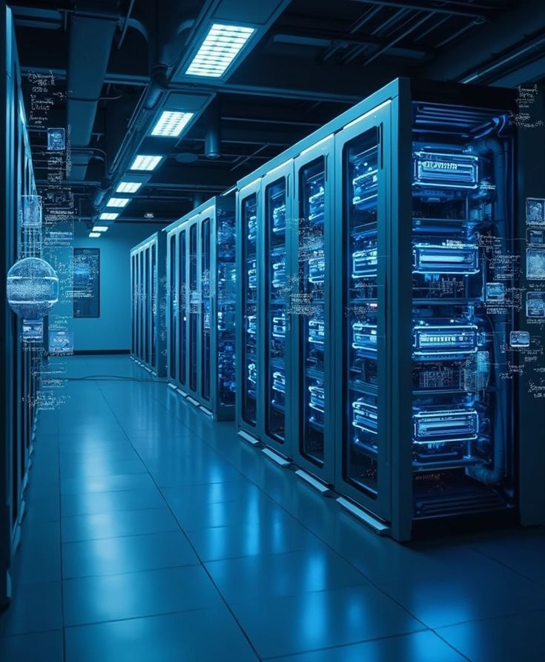


REQUIRED TOOLS & TECHNOLOGIES
To implement this we need to use CISCO PACKET TRACER
For routing protocols we are going to use OSPF & HSRP

Slide 7



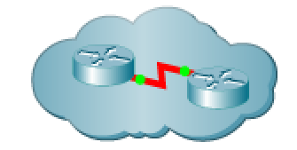










Components
2811 ROUTER
2911 ROUTER
ACCESS POINT
CENTRAL CLOUD
5506 FIREWALL
L2 SWITCH
LAPTOP
IP PHONE
L3 SWITCH
COMPUTER
SMARTPHONE
TABLET
PRINTER
SERVER

Slide 8
Network Overview
1
Three Floors
Distinct departments with unique roles and requirements.
2
Devices used:
PCs, printers, VoIP, ACL,
Firewalls, and servers deployed.
3
Configurations

Slide 9
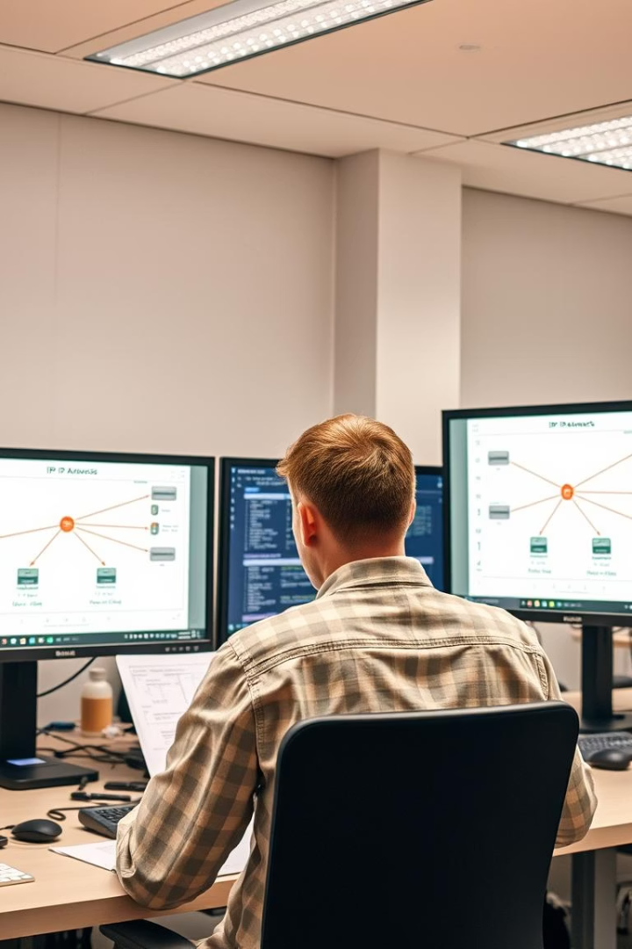
Server infrastructure overview
Key areas include:-
DMZ (Demilitarized Zone)
Application, Email, and NAS storage servers
Connections to VLANs (Virtual Local Area Networks)

Slide 10
Server Interconnections
Servers are interconnected via:-
LACP bonds (Link Aggregation Control Protocol) for better bandwidth and redundancy.
Traffic routing through firewalls for security.

Slide 11
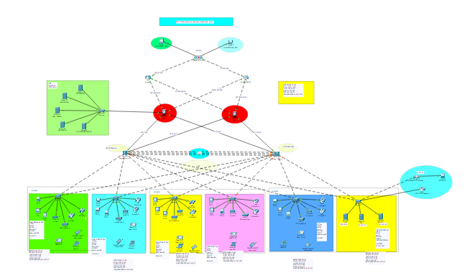
DESIGN

Slide 12
Internet Connectivity: Dual ISP
Redundancy
Primary ISP: Verizon Fios
High-speed fiber at 1 Gbps. SLA ensures 99.9% uptime.
Secondary ISP: Comcast Business
500 Mbps cable connection. Automated failover for resilience.
BGP Configuration
Intelligent path selection between ISPs maximizes uptime and performance.

Slide 13

Wireless Setup: Centralized Wi-Fi
Management
Centralized Management
Meraki dashboard controls all access points efficiently.
Guest Network
Captive portal and policies ensure secure, managed guest access.
Secure Access
802.1x authentication and WIPS protect employee devices.

Slide 14
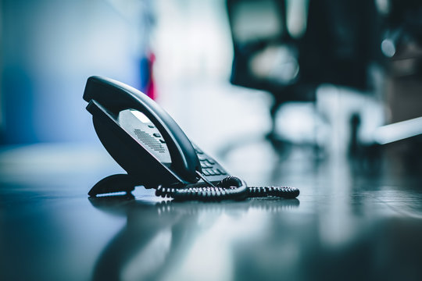
Telephony (VoIP)
Setup: Cisco IP
Phones & Voice
Gateway
Cisco 8841 Phones
10 units deployed for clear, reliable calls.
Voice Gateway
Cisco 2811 router enables SIP trunk integration.
QoS Prioritization
Ensures voice traffic is prioritized for quality.

Slide 15
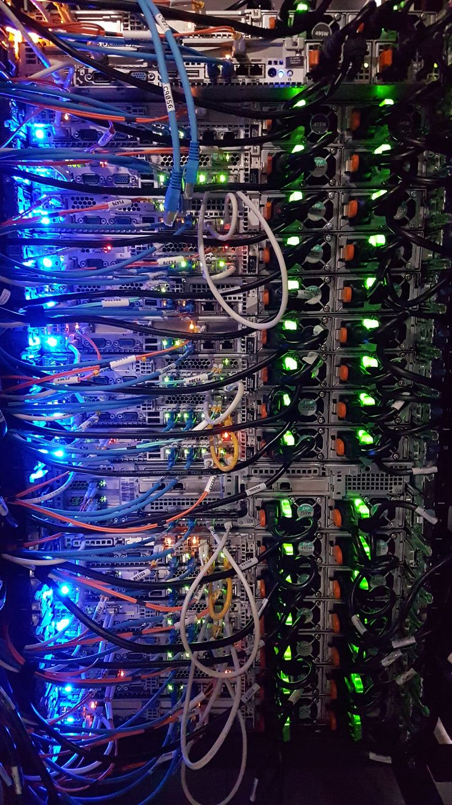
Security Enhancements:
ACLs, SSH, Port Security
Access Control Lists (ACLs)
Filter traffic for protection and compliance
SSH for Remote Access
Secure encrypted connections replace unsecured methods.
Port Security
Prevents unauthorized device connections on switches.

Slide 16
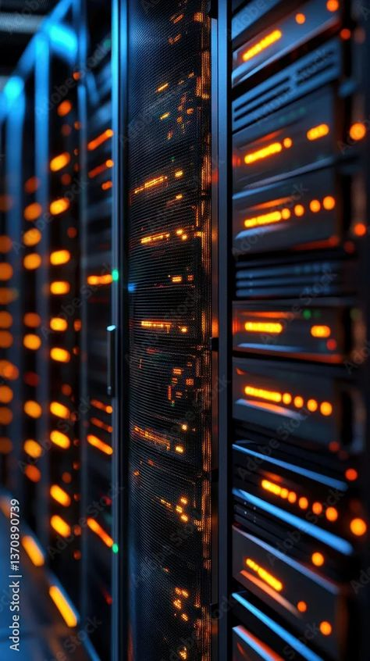
Redundancy Protocols:
HSRP High Availability
HSRP Setup
Ensures gateway redundancy for continuous availability.
Load Balancing
Distributes traffic to optimize resource use and uptime.
Downtime Reduction
Minimized outages with 99% less downtime.

Slide 17
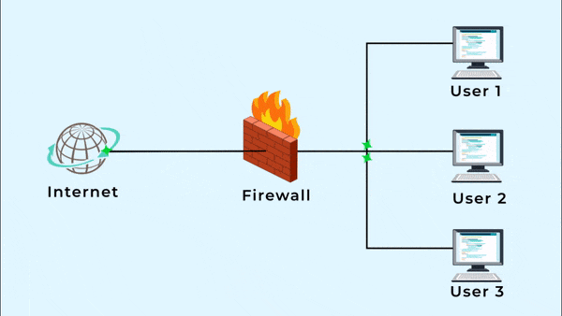
Introduction to Firewalls in Network Security
Definition:-
A firewall is a network security device that monitor and controls incoming and outgoing traffic based on predetermined security rules.
Purpose:-
To create a barrier between a trusted internal network and untrusted external networks, such as the internet.
Types of Firewalls:-
Hardware Firewall:- Cisco ASA (Advanced Security Appliance).
Software Firewall:-
Included in various operating systems.

Slide 18
Security Features Implemented in the Project
Firewall Zones:-
Inside Zone:- Trusted internal network.
Outside Zone:- Untrusted external network (Internet).
DMZ (Demilitarized Zone):- A neutral zone to host public-facing servers while protecting internal assets.
Access Control and Security Policies:-
ACLs to restrict access based on IP, port numbers, and services.
Stateful Packet Inspection:-
Ensures only valid connections pass through the firewall.

Slide 19
Redundancy Protocols:
HSRP High Availability
Strong Security
Comprehensive measures protect sensitive data.
Scalable Design
Allows seamless network expansion without downtime.
Maximized Performance
Ensures high availability and optimized throughput.

Slide 20

THANK
YOU
A special thanks to all the guides involved in this project
including my internal and external guides.
Internal – Dr. Virender Kumar
External – Mr. Gurpreet Singh
Mr. Adarsh Patiyal

